Slide 1


Not Doomsday
AI-Powered Disaster Intelligence Platform
Vedant Ranade
Viraj Paradkar
Vashistha Pandya
Atharva Keskar
Soham Santra

Slide 2
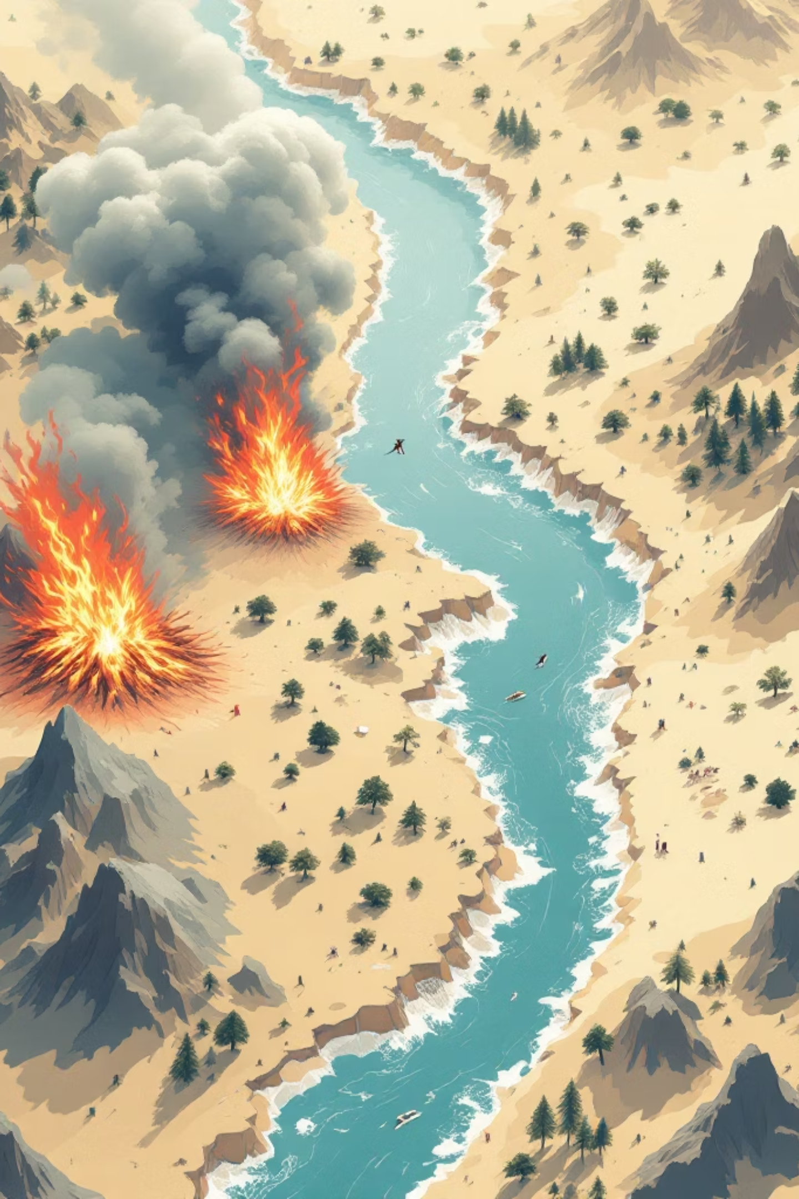
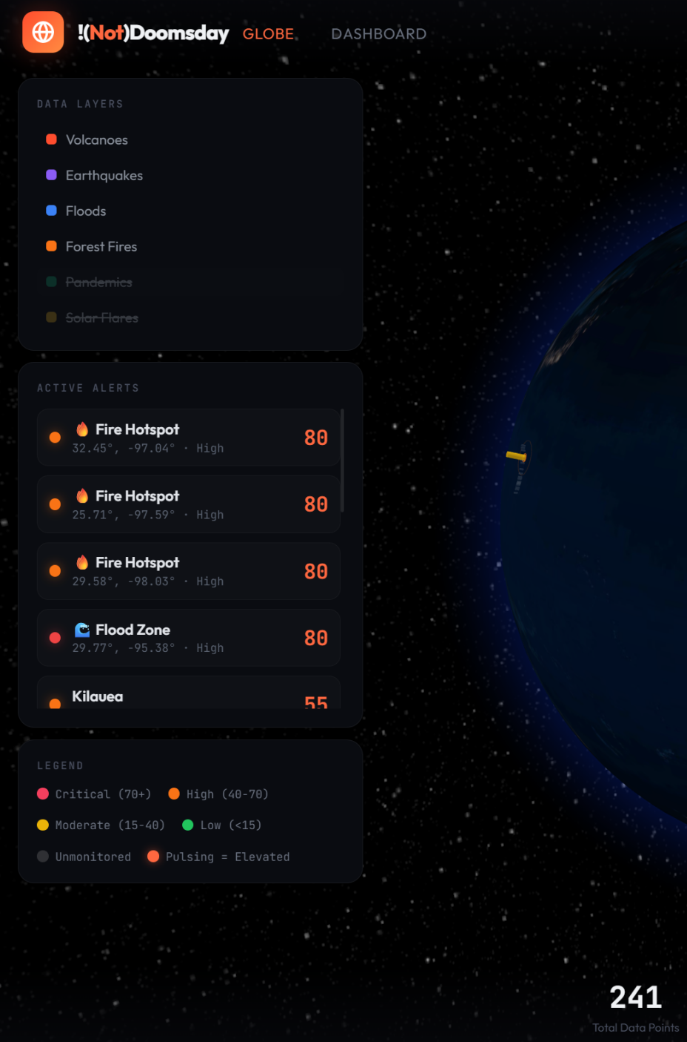
Why Better Prediction Matters Now
The High-Stakes Challenge
Current System Gaps
False alarms erode public trust and waste resources, while missed threats cost lives, property, and economic stability. Emergency managers face an impossible balance between caution and credibility.
Fragmented early warning systems operate in silos, lack real-time validation, and struggle with interconnected threat cascades. Different agencies monitor different hazards without unified risk assessment.
Rising Threat Complexity
Climate change intensifies extreme weather events, while urbanization concentrates populations in vulnerable zones. The intersection of natural and technological hazards demands smarter intelligence.

Slide 3
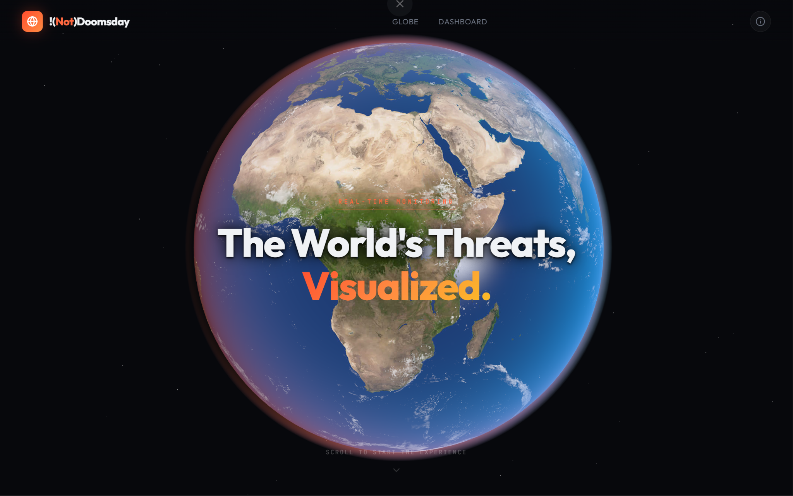
Intelligent Multi-Hazard Analysis Platform
Platform Architecture Overview
A unified AI engine that continuously monitors, analyzes, and validates multi-hazard risks across earthquakes, floods, wildfires, pandemics, solar flares and even volcanoes. Integrates real-time feeds from USGS, NOAA, FIRMS, WHO, and 15+ authoritative sources.
The LLM-powered validation engine applies cascade reasoning to identify interconnected threats and provides confidence scores for every prediction.
1
2
Data ingestion from authoritative sources
Multi-agent AI analysis with cascade reasoning
3
4
Confidence validation across models
Personalized risk assessment delivery

Slide 4

Who Uses “Not Doomsday”
Emergency Management Agencies
Coordination teams receive validated threat assessments with confidence levels, enabling faster resource deployment without false alarms.
Local Governments & Municipalities
Mayors, city planners, and public works leverage location-specific risk profiles for infrastructure planning and evacuation protocols.
Communities & Residents
Personalized alerts by geographic zone ensure relevant warnings reach people who need preparedness guidance.

Slide 5
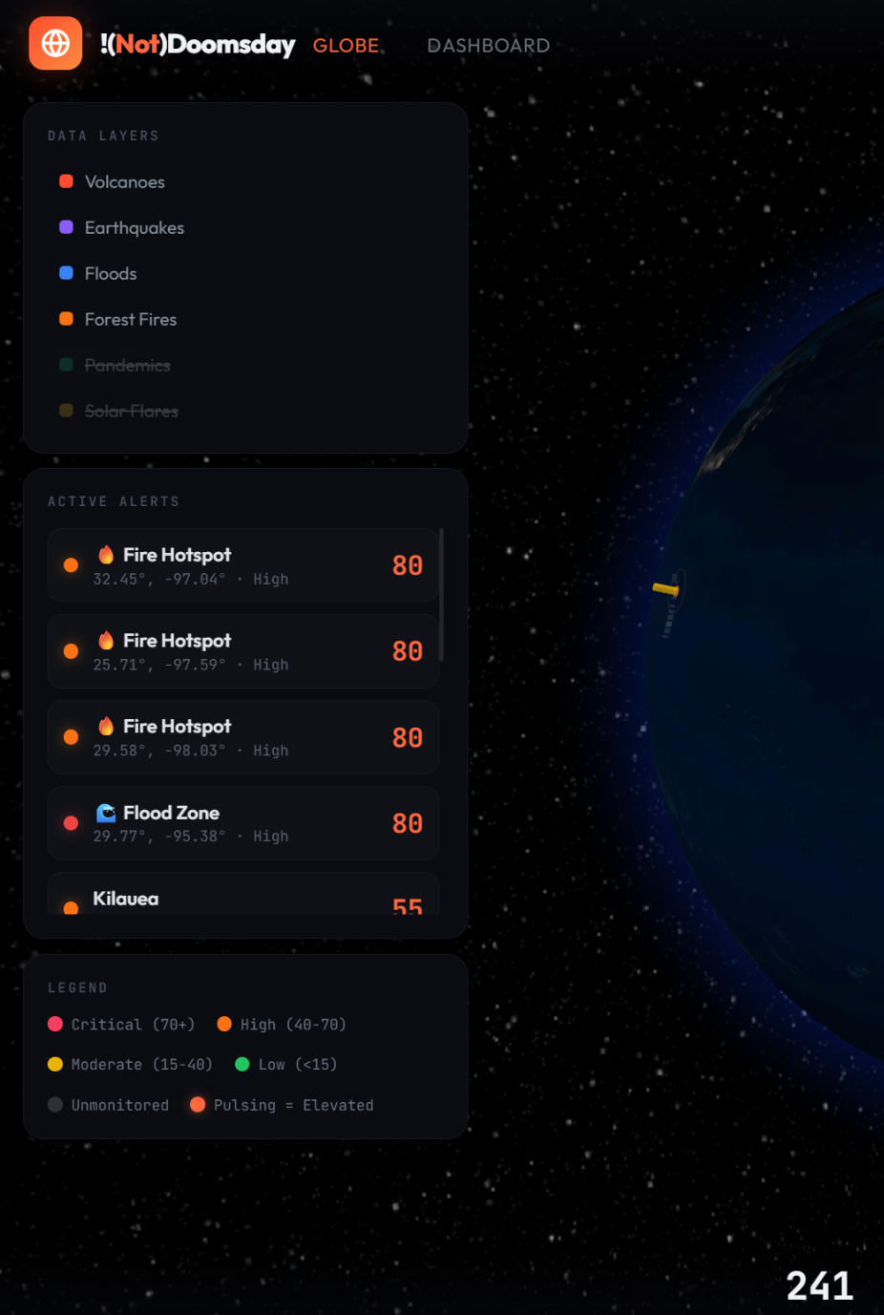
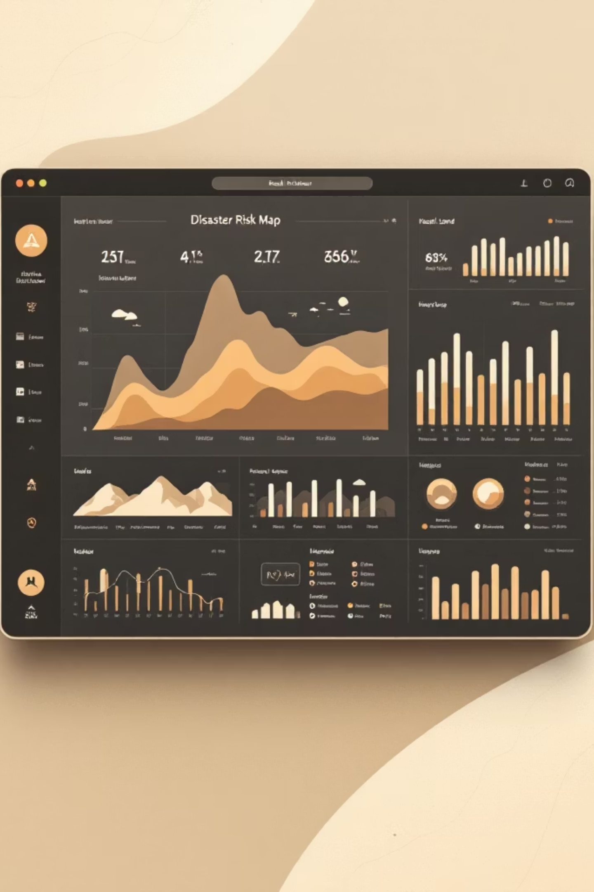
Risk Visualization in Action
1
Fetching Real-Time Data using Trusted API’s
Fetch real-time using trusted API’s like USGS-HANS, NASA-FIRMS, NOAA etc.
2
Multi-hazard analysis initiated
AI Examines the Data in a Modular way to Predict the threats using the data.
3
Validation engine runs
RAG helps to cross-check predictions and assign confidence levels based on historic data.
4
Risk visualization and Mitigation
Color-coded threat matrix with priority recommendations and mitigation guidance

Slide 6

Features
Transparency in Predictions
Mitigation Strategies
Every AI-generated threat assessment includes confidence scores and Reasoning. Users understand why a prediction exists rather than blindly trusting algorithmic output.
Mitigation using Groq and Open Street Map data for optimizing supply chain paths for better disaster management driven infrastructure
Communicating Uncertainty
Multiple Disaster’s covered under one platform
The platform distinguishes "high-confidence threats" from "monitoring advisories" to prevent alarmism. Context-heavy notifications explain probabilistic reasoning in plain language.
We have covered a total of 5 natural disasters :
Volcano, Earthquake, Floods, Forest Fires, Solar Flares and Pandemics

Slide 7

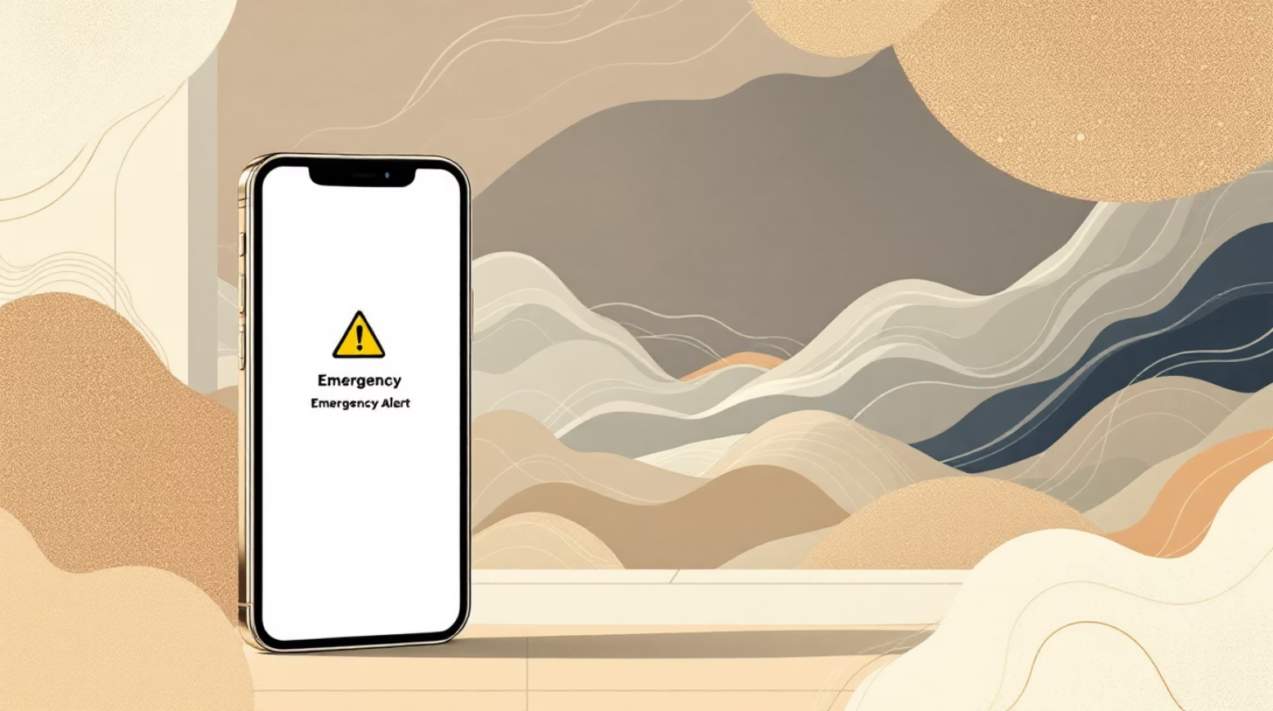
Expanding Our Platform’s Capabilities
Roadmap:
Better models, diversifying dataset by adding more countries and regions so we have more data to show on our maps.
We also want to work on adding more API endpoints and improving visualization wherever we can.
Global flood and fire coverage via GloFAS (Copernicus) and multi-region FIRMS calls — currently US-only
Fine-tune cascade predictions using validated outcomes — did our predicted cascades actually happen?
Economic impact estimation per cascade chain (infrastructure costs, healthcare burden, displacement)
Real-time streaming dashboard with multi-city simultaneous monitoring
Role-based alerts — hospital admins get health cascades, city engineers get infrastructure cascades, field responders get mobile notifications

Slide 8





Thank You for listening, Happy to Answer any of your Queries 😁
Together, we can save lives and build more resilient communities through intelligent disaster prediction. Let's Not Doomsday!!.
sohamsantra04@gmail.com

